Slide 1

Meet The Funder 17th September 2024
Sarah Lafford and Joanna Plaisant
Heart of England Community Foundation
Notes:
DESIGN: - All titles in League Spartan, all sub titles and general content in Lato.
- Titles to be double to side of sub titles and general content.
- Opening and closing side to be Foundation’s pink.
Middle slides to be Foundation’s purple, lilac and yellow.
Suitable images saved in ‘Slideshow Photos’ can be replaced with less general images if required.
Images produced on Canva in a 3” x 5” dimension, a ‘photogenic > belvedere’ effect.
Subtitles can be in a secondary primary colour.
1

Slide 2
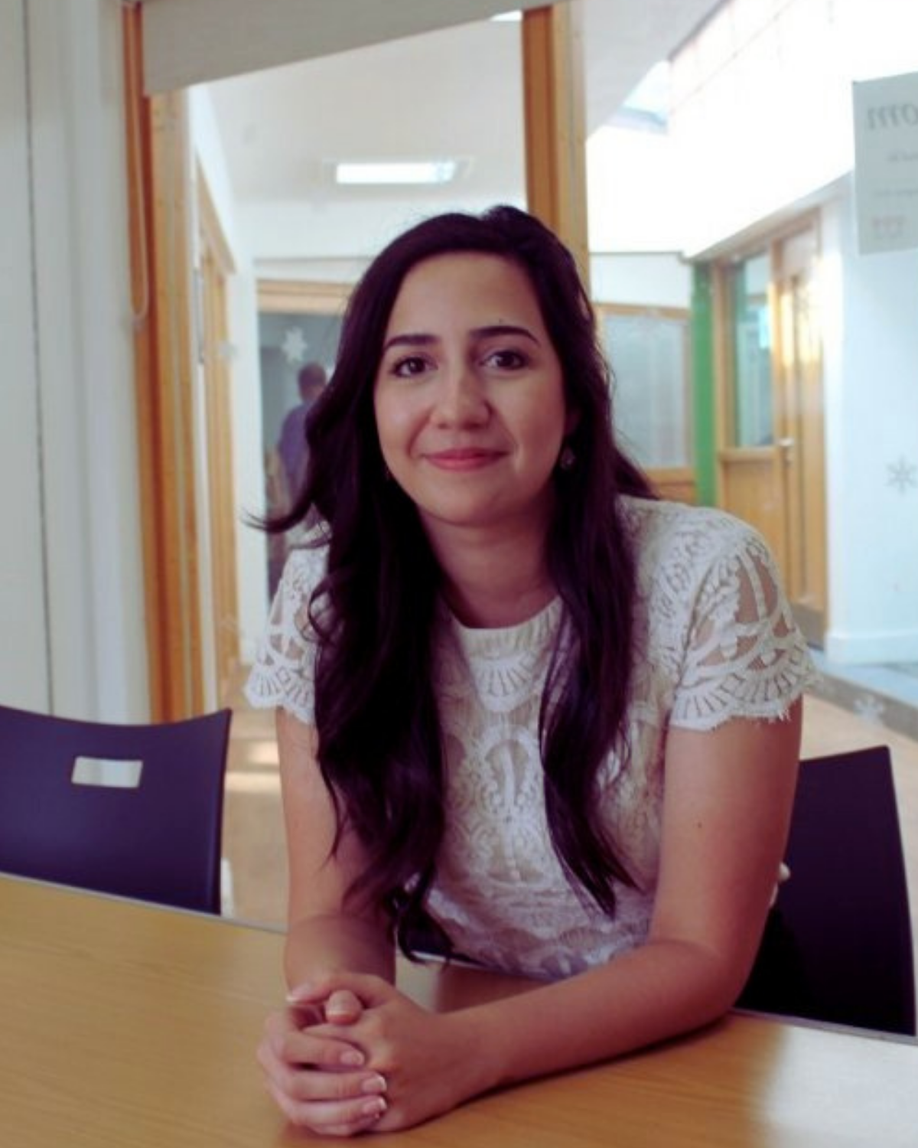

About
Heart of England Community Foundation is a charity that raises money to fund and develop community activity, right across Birmingham, the Black Country, Solihull and Warwickshire.

Slide 3

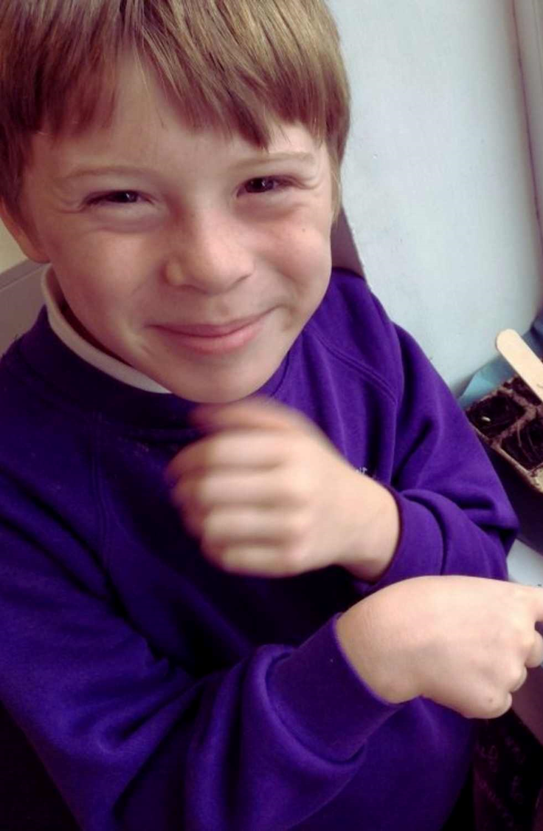
Our Impact
Value for money
93p of each £1 we receive goes back to our communities
Every £1 invested in the Foundation we generated £4.18 of social value
During 2020-21 we received over 1,984 applications and awarded 1,495 grants totalling £5.7m
52% of our grants have gone to organisations within the 20% most deprived areas

Slide 4
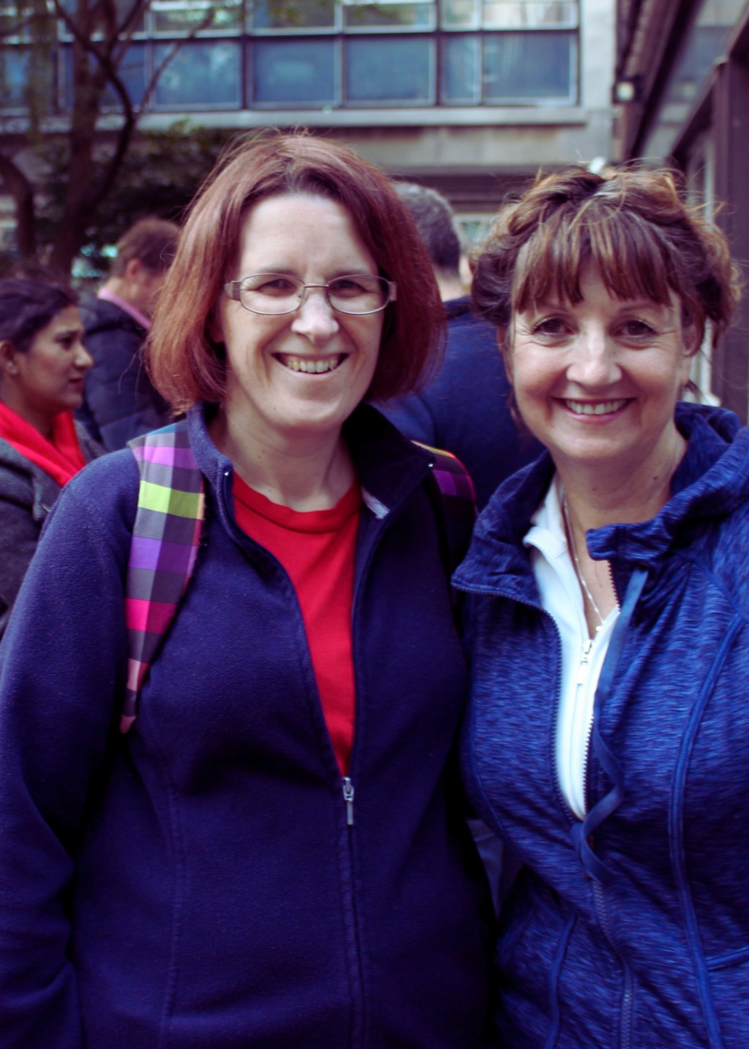
Funding Opportunities
Birmingham Funds
Birmingham and Black Country Community
Positive Futures
Harry Payne Fund
IM Properties Community Fund
Dulverton Trust

Slide 5
Birmingham and Black Country Communities Fund (BBCC)
Maximum of £3,000
Supports people in Birmingham and the Black Country.
The aims of the fund are to strengthen communities.
Will fund start up costs, existing projects, pilot projects and the purchase of equipment and resources.
Notes:
There’s grant of up to £3,000 for organisations in Birmingham and the Black Country. Funding must be spent within 1 year.
The fund aims to support people in Birmingham and the Black Country Coventry. Applications must meet one of the following aims: • Promote health and wellbeing • Tackling disadvantage • Support local solutions to meet local needs • Promote community cohesion • Develop sustainable and supporting communities
5

Slide 6
Positive Futures
Grants up to £5000
Practically helping young people to develop skills so they are prepared for work e.g. opportunities to gain work experience and mock interviews with employers.
Supporting young people who are in the process of leaving care so that they develop skills to live independently.
Raising aspirations of young people by offering organised mentoring opportunities – these opportunities should have an individualised plan which shows growth and clear outcomes for each individual.
Projects supporting mental health of young people on the periphery of crime.

Slide 7
The Harry Payne Fund
Majority of grant £1,500 and below
No deadline – panel meets quarterly
25 – mile radius of Birmingham City Centre
Broad range of activities and will support core costs
CICs not supported
Notes:
Grants normally range between £250 and £2000 although exceptionally we will go higher
than this.
• funding to be spent within 1 year.
• Applicants will be expected to demonstrate evidence of need and – particularly in the case
of project finance – where the balance of the required funding is coming from.
The fund aims to:
• Help smaller causes where a modest donation can make a difference.
• Support core costs as well as specific projects.
We have a strong preference for supporting Registered Charities and Charitable
Incorporated Organisations
7

Slide 8
The IM Properties Community Fund
Maximum Grant Size £3,000, addressing one of the following priorities as part of IM Properties Sustainable Futures Framework.
PEOPLE
Promoting positive change projects that:
Support health and wellbeing.
Promote inclusion and diversity within the community.
PLACE
Strengthening communities projects that:
Promote and encourage community cohesion.
Tackle social isolation and/or help to build social networks.
Help to raise aspirations and provide learning opportunities for children, young people, adults and families.
Notes:
8

Slide 9
IM Properties Continued
PLANET
Enhancing the natural environment projects that:
Promote education and awareness of sustainability
Encourage resource efficiency by reduction, recycling and reusing of waste materials
Support environmental initiatives including wildlife and habitat creation
No deadlines – panel meet quarterly
Notes:
9

Slide 10
The Dulverton Trust
Maximum grant size £5,000 & funding must be spent within 1 year
Priorities: - Youth opportunities - General welfare - Conservation - Heritage
Panel meetings for the Fund will take place on:
October 2024
February 2025
Notes:
What we will support: Start-up costs for a new project or organisation • To extend or develop an existing project • For pilot project (to gather research or evidence) • To purchase equipment or resources
Your organisation/company income level must be equal to or less than £200,000, as shown in your most recent annual accounts
Will not fund:
Work that addresses the impact of mental or physical illness, or specific health conditions.
This includes the delivery of healthcare including treatment, medical research, counselling
and therapy, and treatment relating to drug and alcohol misuse
• Advancing religion
• The arts, including theatre, music and drama (except when used as a means of achieving
one of our funding priorities)
• Sports*, including sports centres and individual playing field projects (except when used as
a means of achieving one of our funding priorities

Slide 11
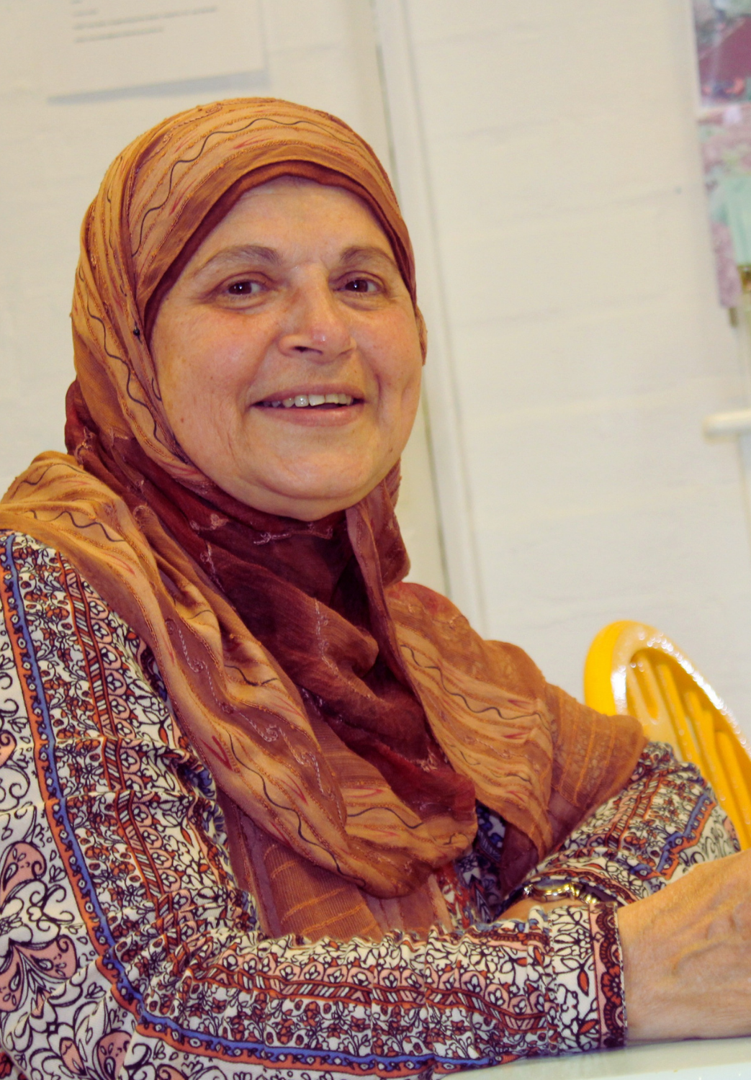

Eligibility Checklist
What type of organisation are you?
How much do you need?
Who has overall responsibility?
Do you have necessary documents in place?
Annual income?
Bank account
How many grants from this Foundation do you have?
Notes:
Eligibility Checklist
11

Slide 12
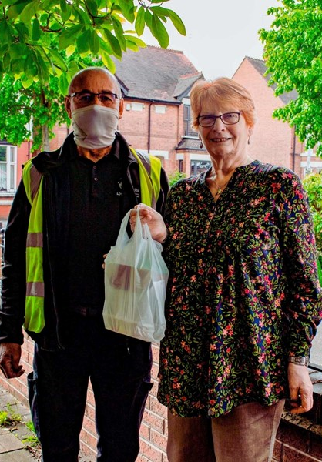
How To Apply
Online > heartofenglandcf.co.uk
Supporting Documents
Application deadlines
Assessment – takes up to ten weeks
Decision
End of Grant Monitoring Report
Notes:
12

Slide 13
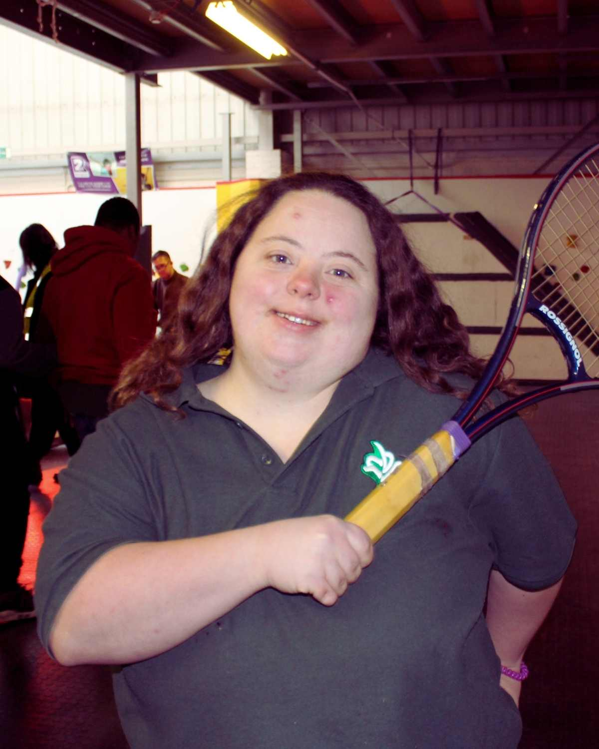
Hints & Tips
Read Fund Factsheet
Supporting documents
Check Essential Information
Be clear & concise – why, what, how, where, when, who, how much
SAVE
Ask a friend

Slide 14

Any Questions?

